Slide 1
Relational DataBase
Database, Data warehouse, Data lake
SQL
SSIS
DQS

Slide 2

Amin Shahab (MSc)
Data Scientist, Data Analyst, Developer

Slide 3
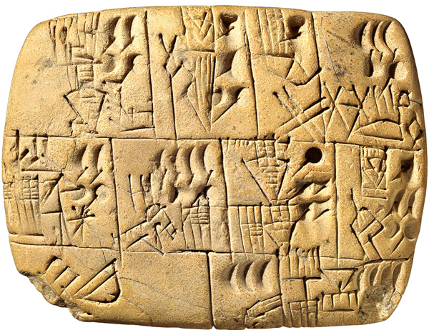

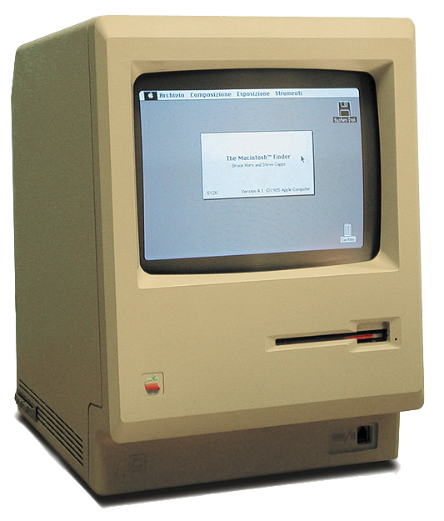
History
The need to keep information
To remember
To pass to next generation
To calculate

Slide 4
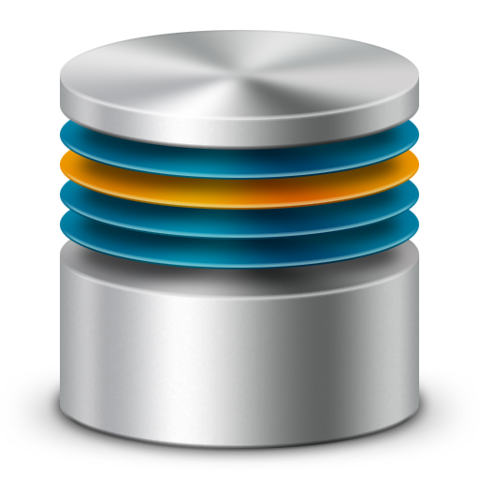

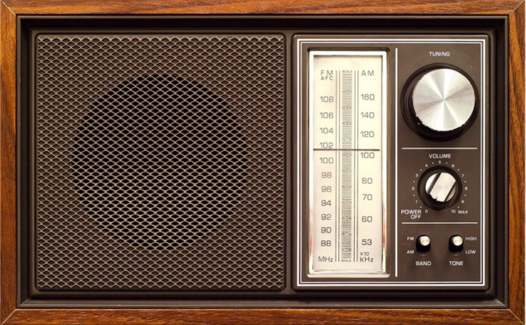
History
The need to share information
We need centralized controlled database
- Managing file size - indexing
- backup restore - transaction
- …
Notes:
It is local - FTP access to one file is limited

Slide 5
RDBMS
Stand on Relational DataBase Management System
Is a software that manage,
Oracle, MS SQL Server, DB2, MySQL ...

Slide 6
Design
ER Diagram
https://creately.com/diagram/example/ijxshs852/banking+system+database+design?utm_source=pinterest&utm_medium=social&utm_campaign=pinerd
Normalization
https://support.microsoft.com/en-ca/help/283878/description-of-the-database-normalization-basics
De-Normalization

Slide 7
Syntax
Oracle -> PL/SQL
SQL server -> T-SQL (Transact SQL)
Oracle -> PL/SQL
DDL - Data Definition Language
Alter - Disable Trigger - Enable Trigger
Collations - Create - Rename
Drop - Update STATICS
DML - Data Manipulation Language
Bulk Insert - Delete - Update
Merge - Truncate Table
https://docs.microsoft.com/en-us/sql/t-sql/statements/statements?view=sql-server-ver15

Slide 8
Syntax cont.
DDL - Data Definition Language
DML - Data Manipulation Language
DQL - Data Query Language - Select
DCL - Data Control Language - Grant - Revoke
TCL - Transaction Control Language - Commit - Rollback

Slide 9
Database vs Schema
Database -> File(s) contains all the data, structure, control rull, etc.
DBMS -> software that manage database
Other software (include DBs like SSMS) communicate with DBMS
Schema -> Manage the

